Slide 1
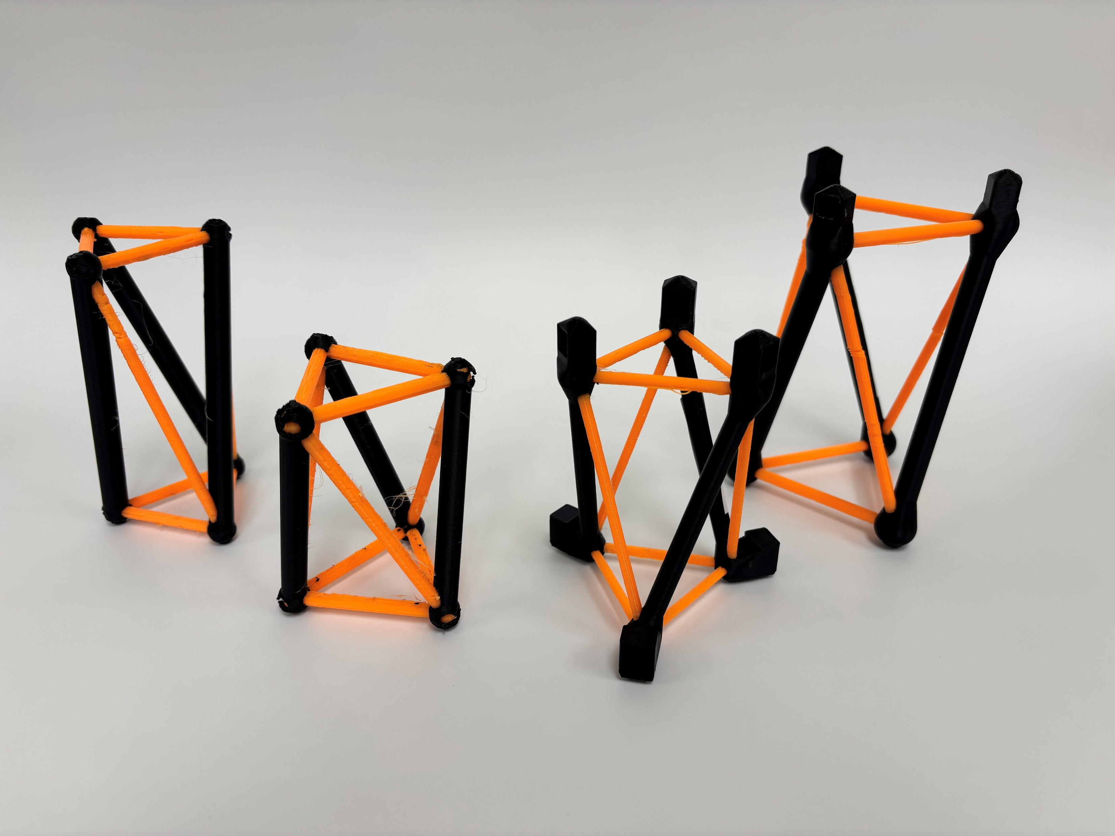

Let’s build better tensegrity structures faster
Marcus Madsen
Research Assistant
IDETC 2026
Notes:
Title is a bit of a placeholder. Maybe adjusting it to include/more explicitly state what the presentation is on: i.e. optimizing tensegrity-inspired energy absorbers with real impact data and Bays opt. Probably could use an image in the center or a graphic like in the original slides. Tensegrity structures there as a placeholder mostly.
Use this slide to introduce myself and then swing into next slides posing the question of why we might want tensegrity or tensegrity inspired structures at all.

Slide 2
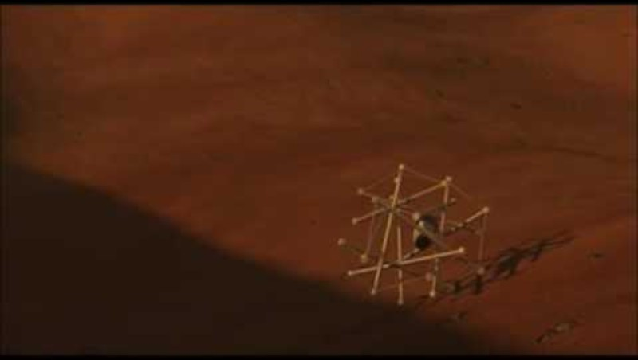
Tensegrity provides robust, reusable, solutions to issues posed by planetary landings—and to problems closer to home.
Notes:
Replace this video with a downloaded and trimmed version of just the fall.
Landing a payload on another planet means surviving an impact in conditions where parachutes and retrorockets struggle — thin atmospheres, rough terrain. NASA's Super Ball Bot concept answers this with a tensegrity structure: the lander is the energy absorber. And unlike crushable aluminum honeycomb or sacrificial airbags, a tensegrity lander can take the hit and get back up — it survives multiple drops and keeps working.

Slide 3
Could use a slide to talk about why tensegrity is useful (i.e. avoiding mechanical ware due to struts isolated in sea of tensile moments)
*a gif showing an elbow joint bending back and forth to indicate mechanical grinding friction*
*Gif showing tensegrity part being squished to indicate part can stay in elastic region under applied stress*
Notes:
This might be better explained purely vocally while on the previous slide.

Slide 4
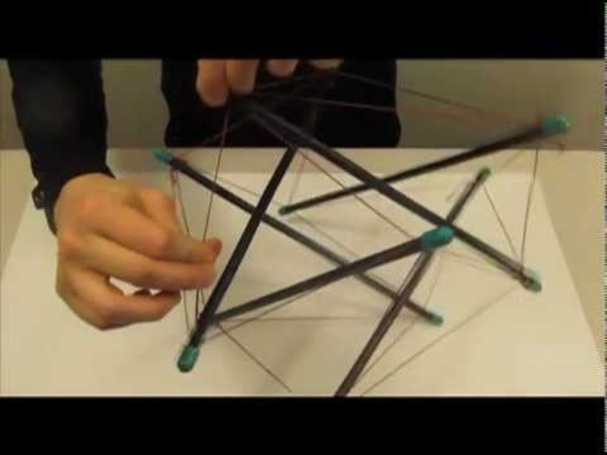


Currently, tensegrity design is slow and resource intensive.
Iteration
Testing
Building
Notes:
Change out video with a downloaded and timelapsed version set to play once the slide opens (silent). Maybe only do an image of the loading thing so that it doesn’t become distracting because it’s fun to watch it spin.
Use this slide to talk about the current reality and difficulties of optimizing tensegrity structures, how the need is for this process to be significantly faster. Reality: testing is costly in time and resources. Building is costly in time. Iteration can be very costly in time. Quick iteration, building, and testing is very desirable to advance any technology.

Slide 5
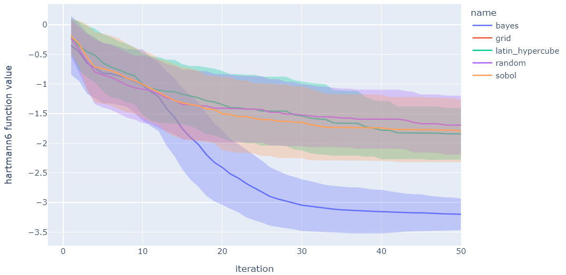

Bayesian Optimization makes physical experimentation affordable.
Property
($↓$ is better)
Design of Experiments
(Traditional)
Bayesian Optimization
0
50
Experiment #
Baird et al. Matter (2022)
Notes:
Consult Sterling on this slide. I don’t want to rip off of his slides (this is one of his slides); it would be helpful to have his input on what kind of imagery / coverage he foresees being most useful of Bays Opt in this presentation. Maybe it’s well enough known that it’d be simply better to discuss HOW we use Bays Opt and not spend time on WHAT it is.

Slide 6
Model calibration and testing are costly, so we need to be careful about what specimens we choose.
*Image over white of two separate T-3 prisms with obviously different characteristics (different size, tendon diameters, etc.)
Notes:
Personally, I feel like this could simply be stated verbally while talking about the benefits of Bayesian Optimization not needing to map out the entire search space.

Slide 7
Bayesian optimization makes physical experimentation affordable, even with limited, noisy data.
2 objectives
6 variables
*image of blackbox*
2 types of input data
Notes:
Very rough slide as I’m not entirely sure what graphic or text to put on this, partially because I’m not sure how much I will need to explain about Bayesian Optimization. If we went with something like this

Slide 8
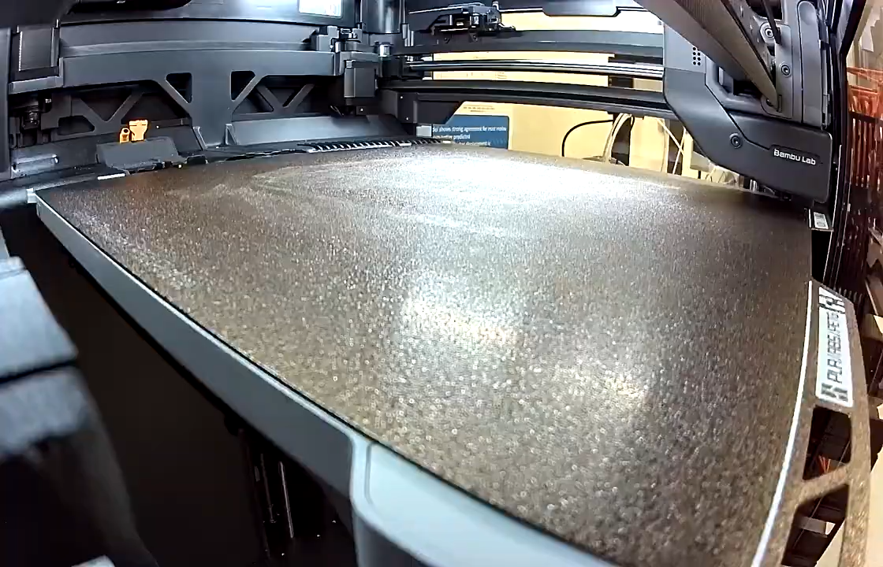
Multi-material additive manufacturing supplies that data fast — single-build co-fabrication, with no joining of parts.
Notes:
Notes made in here about the difference between real and these tensegrity inspired structures, including the lack of purely tensioned members.

Slide 9
We use a drop tower and accelerometers to gather real data on these 3D-printed specimens.
*placeholder for looped gif of drop test at 60 in*
*placeholder for slo motion of drop test*

Slide 10
By connecting these ideas, we significantly accelerate the workflow to optimize tensegrity inspired structures:
Printing
BO feed
Testing
Notes:
I think it might be better if we replaced “printing” with a printed tensegrity image, testing with an image of the drop tower, and BO feed with a blackbox.

Slide 11
Reserved for results
Notes:
Would be helpful if we could show that this process works in this case.

Slide 12
We will take this workflow and use it for some of the vast potential applications of tensegrity.
*image to show lattice structure
*image of crutch tip, perhaps from that paper and properly attributed*

Slide 13
Notes:
Slide for questions at the end

